Slide 1

Project Work - II
Department of Computer Science and Engineering
OFF - CAMPUS Internship
from
“ RWS Moravia India Private Limited”
Submitted To: Submitted By:
Dr. Kailash Bandhu Pragya Sardar
Mr. Binod K Mishra EN18CS301171

Slide 2
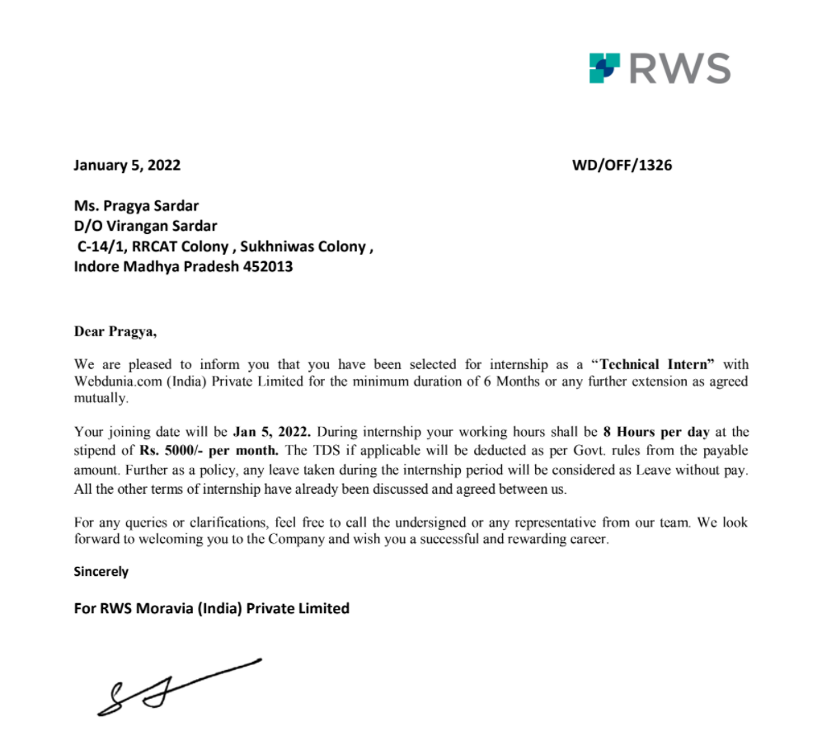
Offer Letter

Slide 3
Contents
Company Profile
Apache Spark
Apache Spark VS Hadoop
Apache Spark Components
Apache Spark Architecture
Apache Spark RDD
Apache Spark Data Frames
Apache Spark Installation
Scala
Proposed Project
Objective
Scope
Conclusion

Slide 4
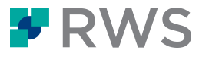
About RWS MORAVIA
RWS Moravia is a leading globalization solutions provider, enabling companies in the IT, consumer electronics, retail, media and entertainment, and travel and hospitality industries to enter global markets with high-quality multilingual products and services.
RWS Moravia’s solutions include localization, testing, content creation, machine translation implementations, technology consulting, and global digital marketing services.
Website : https://www.rws.com/

Slide 5
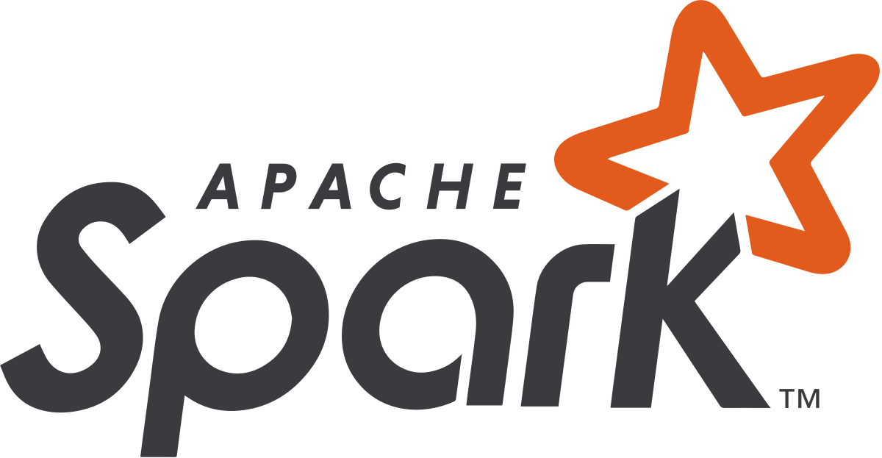
Apache Spark
Apache Spark is an open-source, distributed processing system used for big data workloads.
It provides development APIs in Java, Scala, Python and R, and supports code reuse across multiple workloads—batch processing, interactive queries, real-time analytics, machine learning, and graph processing.
FEATURES:
Fast Processing
Flexibility
In-memory computation
Real Time Processing
Fault Tolerance in Spark
Advance Analytics

Slide 6
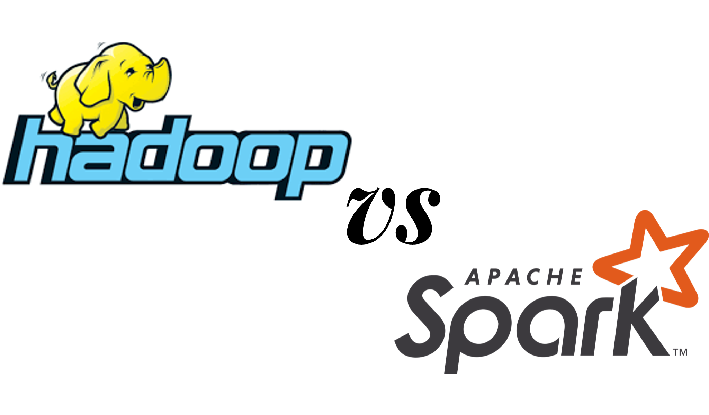
Apache Spark VS Apache Hadoop
Performance
Cost
Processing
Scalability
Security
Machine learning (ML)

Slide 7
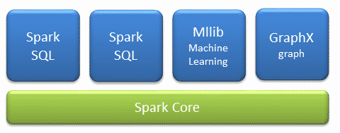
Apache Spark Components
The Spark project consists of different types of tightly integrated components. At its core, Spark is a computational engine that can schedule, distribute and monitor multiple applications.

Slide 8
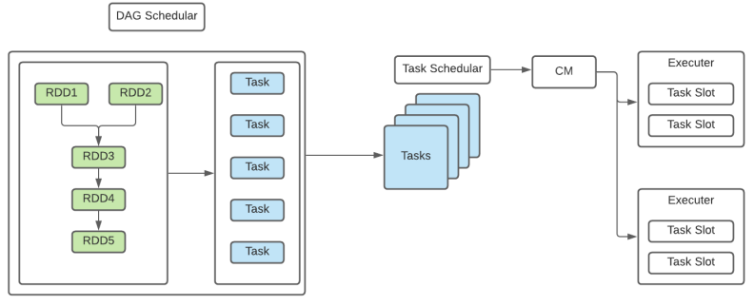
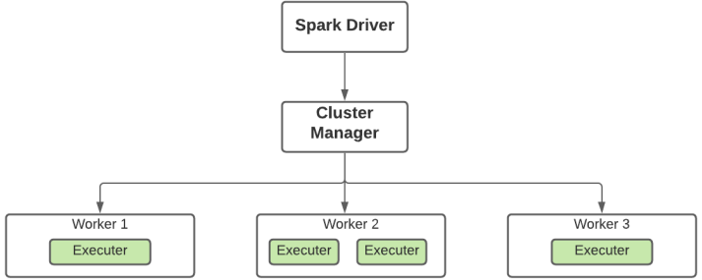
Apache Spark Architecture

Slide 9
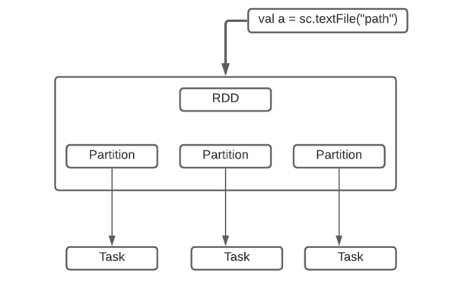
Spark RDD - Resilient Distributed Dataset
Resilient Distributed Datasets (RDD) is a fundamental data structure of Spark.
It is an immutable distributed collection of objects. Each RDD is divided into logical partitions, which may be computed on different nodes of the cluster.
FEATURES:
Immutable
Performs Lazy Evaluation
In-memory computation
Real Time Processing
Fault Tolerance in Spark

Slide 10
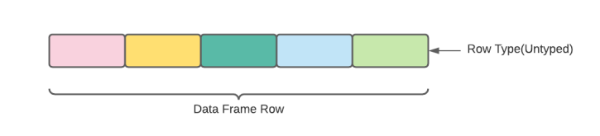
Apache Spark Data Frames
A Data Frame is a distributed collection of data, which is organized into named columns.
Conceptually, it is equivalent to relational tables with good optimization techniques. A Data Frame can be constructed from an array of different sources such as Hive tables, Structured Data files, external databases, or existing RDDs.
This API was designed for modern Big Data and data science applications taking inspiration from Data Frame in R Programming and Pandas in Python

Slide 11
Apache Spark Data Frames
FEATURES:
Use of Input Optimization Engine
Handling of Structured Data
Custom Memory Management
Flexibility
Scalability

Slide 12
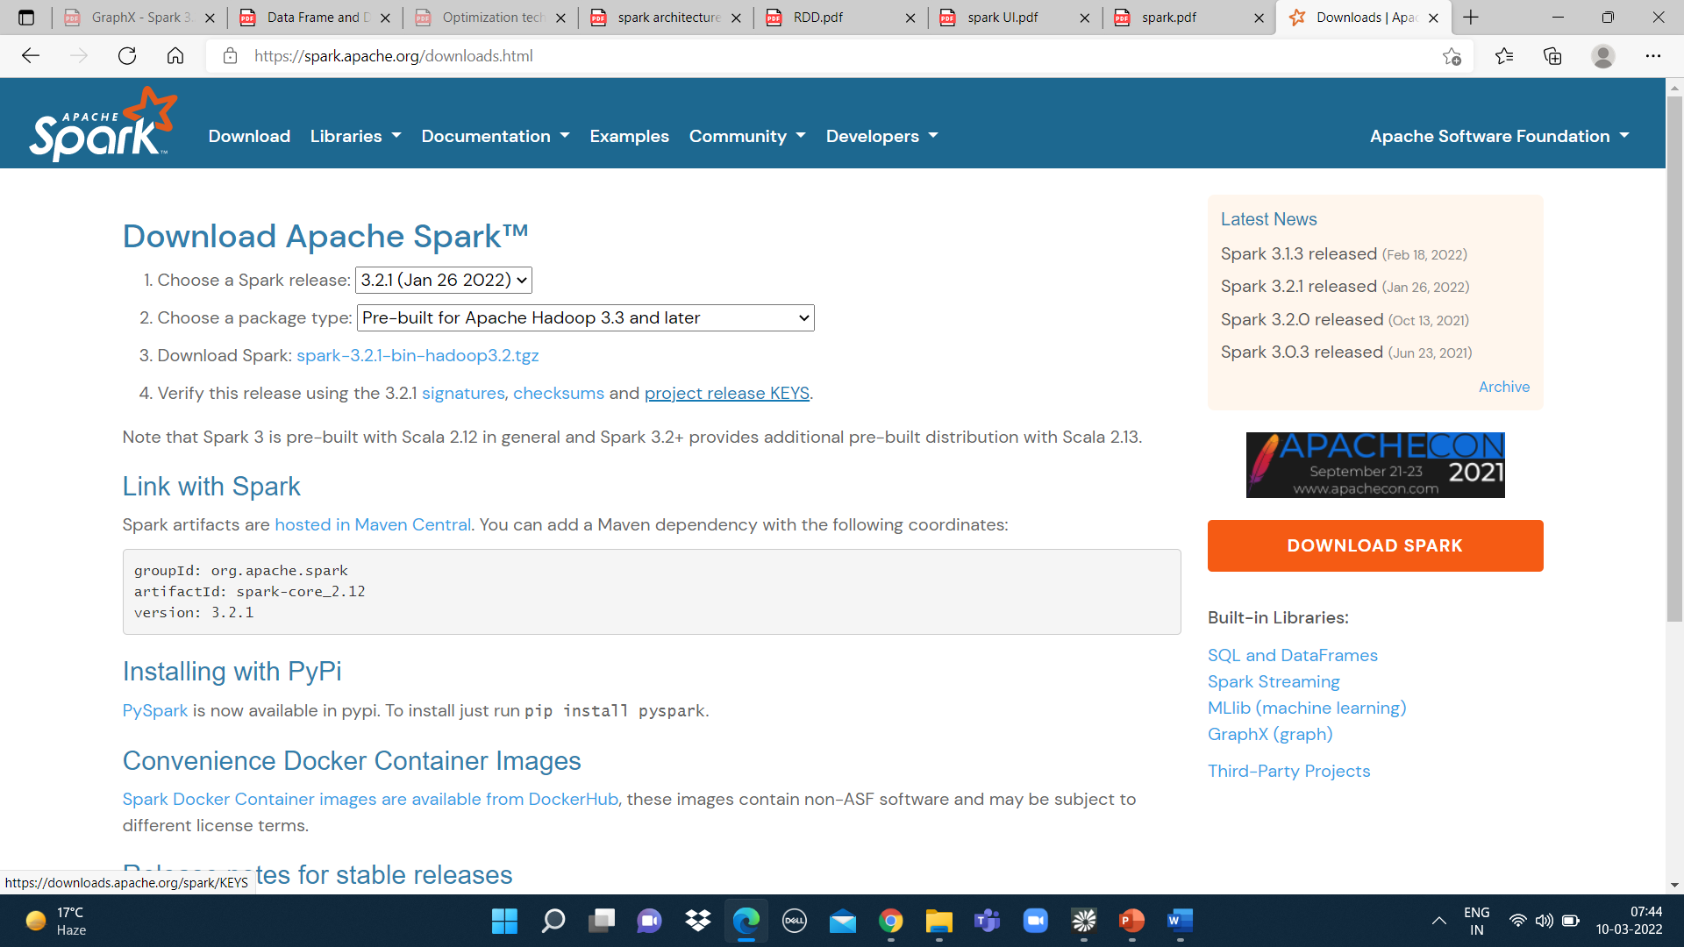
Spark Installation

Slide 13
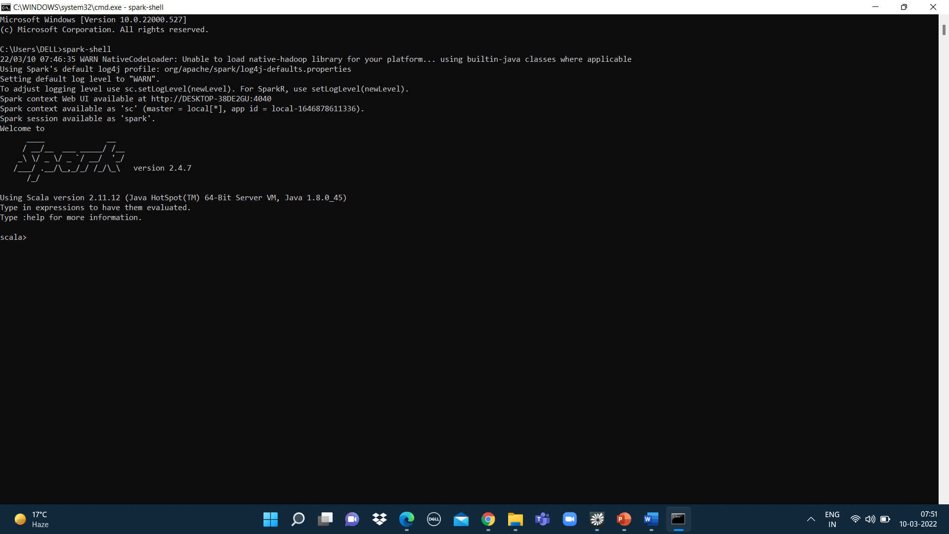

Slide 14
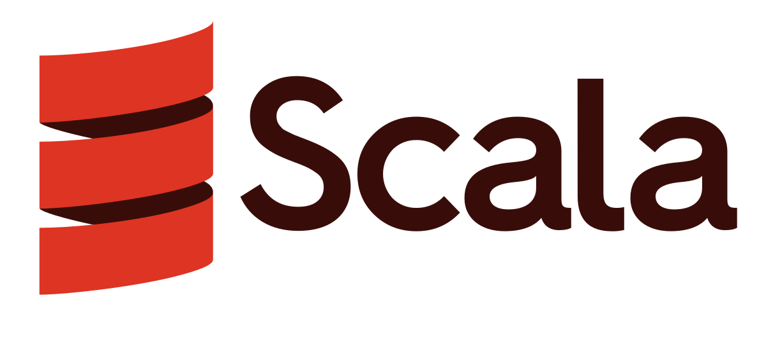
Scala - Scalable Language
Scala combines object-oriented and functional programming in one concise, high-level language.
Scala has been created by Martin Odersky and he released the first version in 2003.
Scala's static types help avoid bugs in complex applications, and its JVM and JavaScript runtimes let you build high-performance systems with easy access to huge ecosystems of libraries.
FEATURES
Object Oriented Language
Statically Typed
Run on JVM
Functional

Slide 15
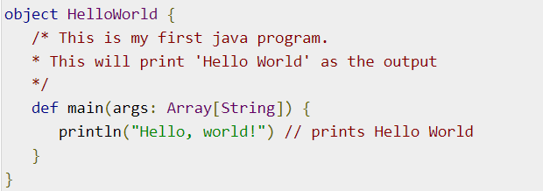

Scala Code
Scala Program Example
Compile and execute the Scala program.
OUTPUT

Slide 16
Proposed Project
Project Title: Link Prediction for Social Networking
Technologies Used: Apache Spark (GraphX)
Language Used: Scala

Slide 17
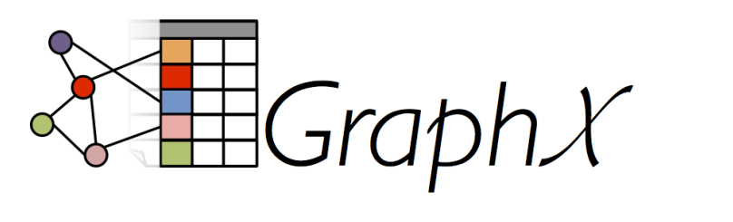
Apache Spark - GraphX
GraphX is a new component in Spark for graphs and graph-parallel computation.
At a high level, GraphX extends the Spark RDD by introducing a new Graph abstraction: a directed multigraph with properties attached to each vertex and edge.
To support graph computation, GraphX exposes a set of fundamental operators (e.g., subgraph, joinVertices, and aggregateMessages) as well as an optimized variant of the Pregel API. In addition, GraphX includes a growing collection of graph algorithms and builders to simplify graph analytics tasks.

Slide 18
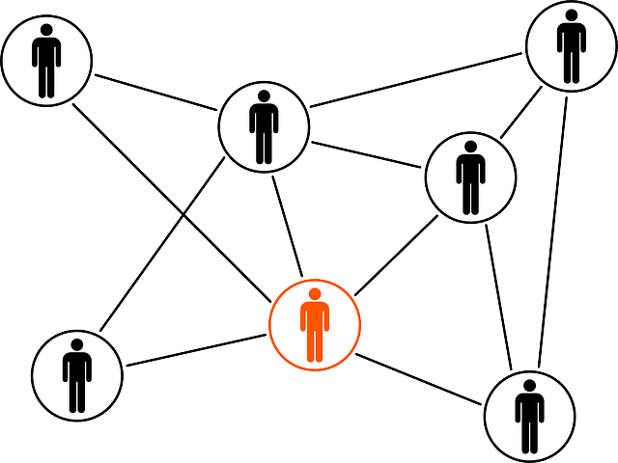
Objective
The objective of link prediction is to identify pairs of nodes that will either form a link or not in the future.

Slide 19
Scope of Proposed Project
Link prediction has a ton of use in real-world applications. Here are some of the important use cases of link prediction:
Predict which customers are likely to buy what products on online marketplaces like Amazon. It can help in making better product recommendations.
Suggest interactions or collaborations between employees in an organization.
Extract vital insights from terrorist networks.

Slide 20
Conclusion
Link prediction and entity resolution are two ways to identify missing information in networks.
Link prediction helps identify edges that are likely to appear in the future, if they do not exist already.

Slide 21
Thank You!

